Slide 1
SafeGaze Design and Architecture
Reece Davies

Slide 2
Architecture

Slide 3





SafeGaze
Video camera
Video camera
PC running OBS Studio
YouTube
Video camera

Slide 4
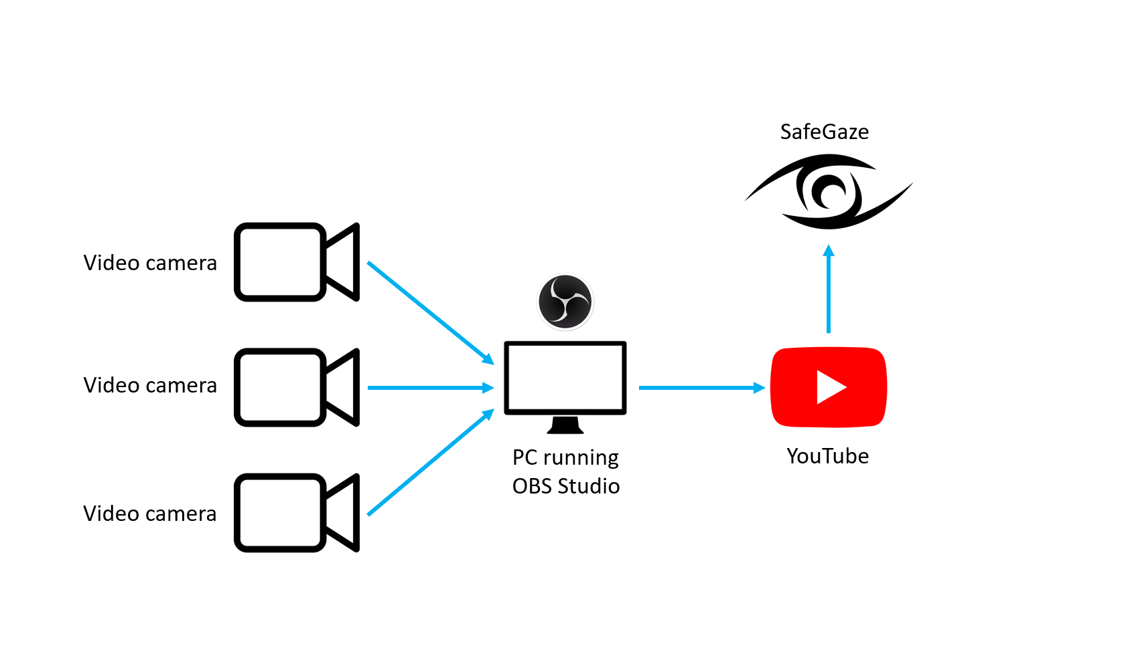

Slide 5


SafeGaze
Client
(facility & members)
PHP application
Webserver & database hosting
Video camera
Video camera
PC running OBS Studio
YouTube
Video camera

Slide 6
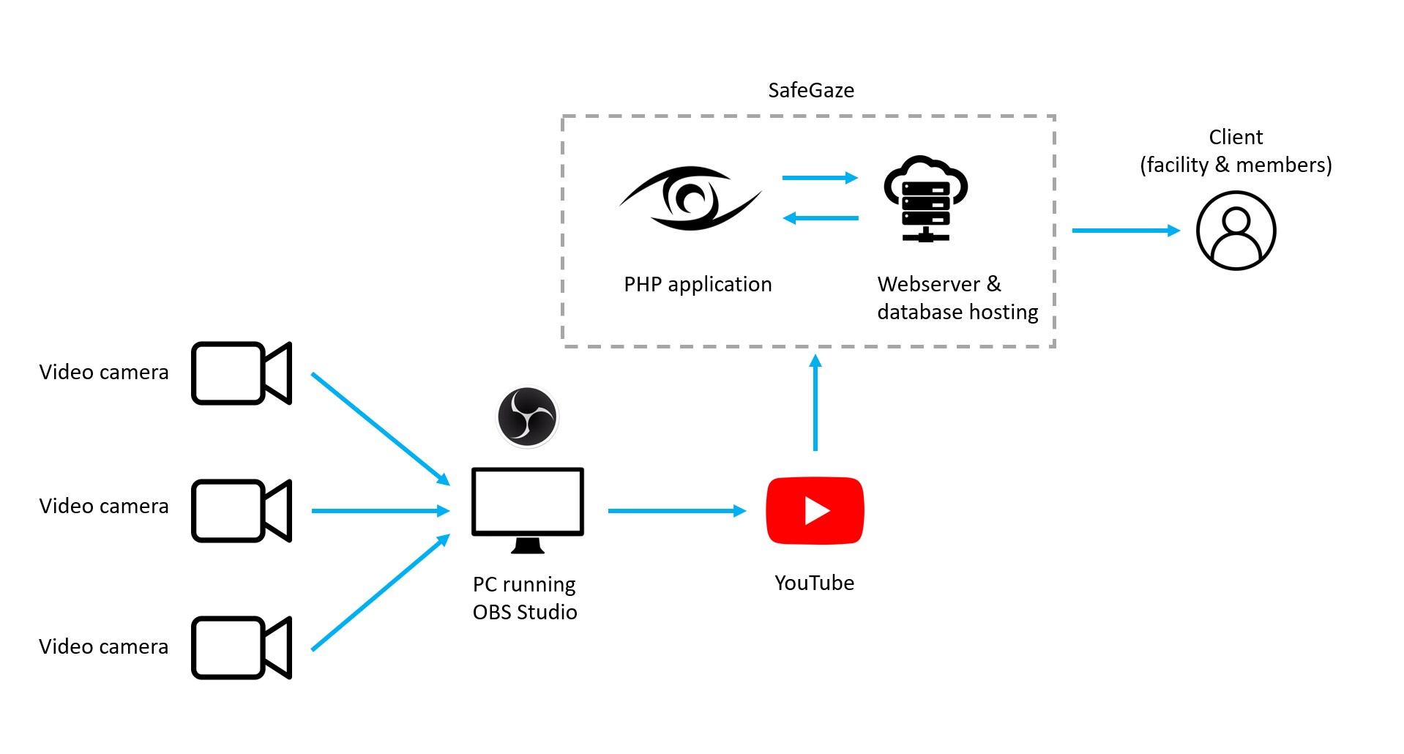

Slide 7
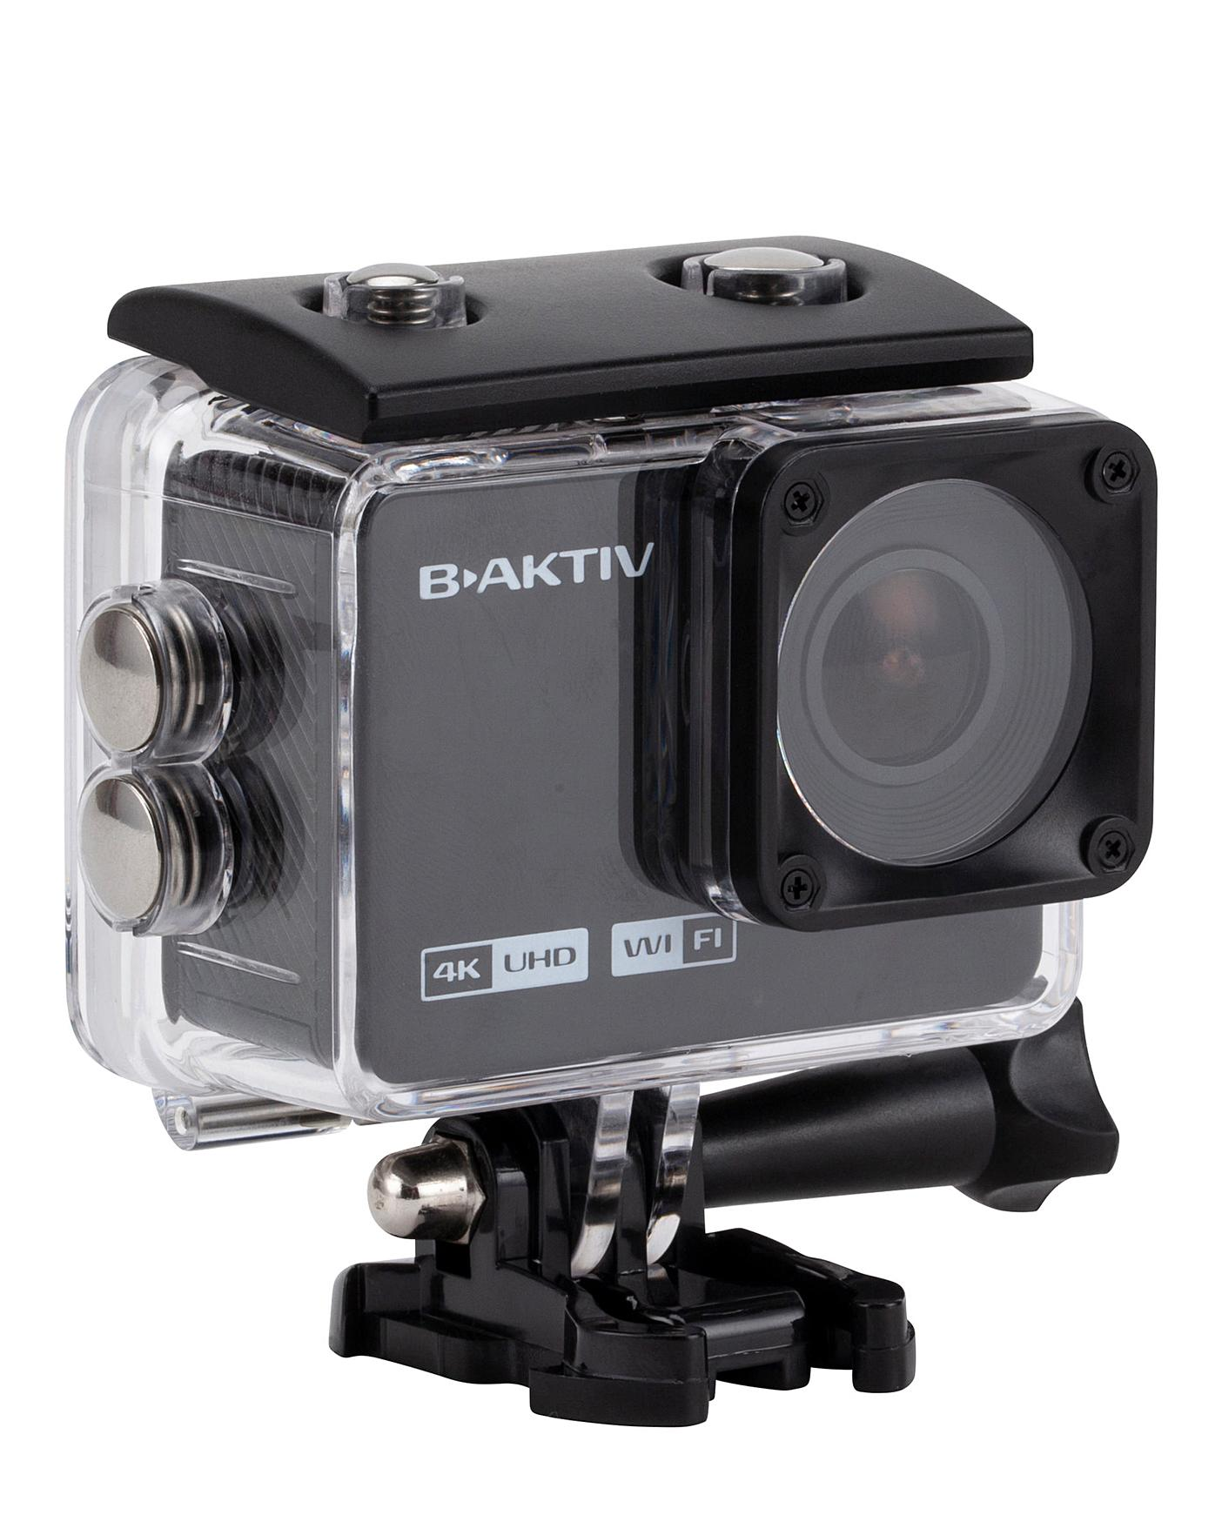

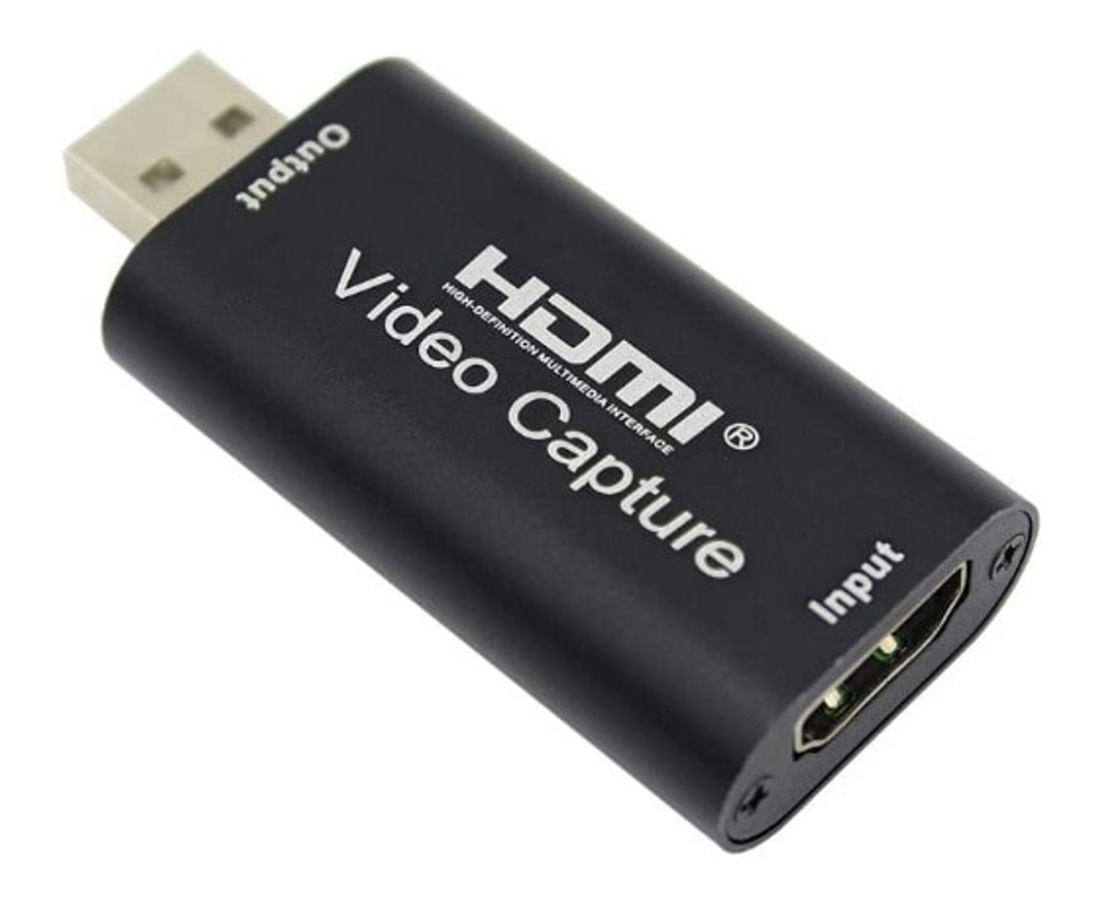

Slide 8
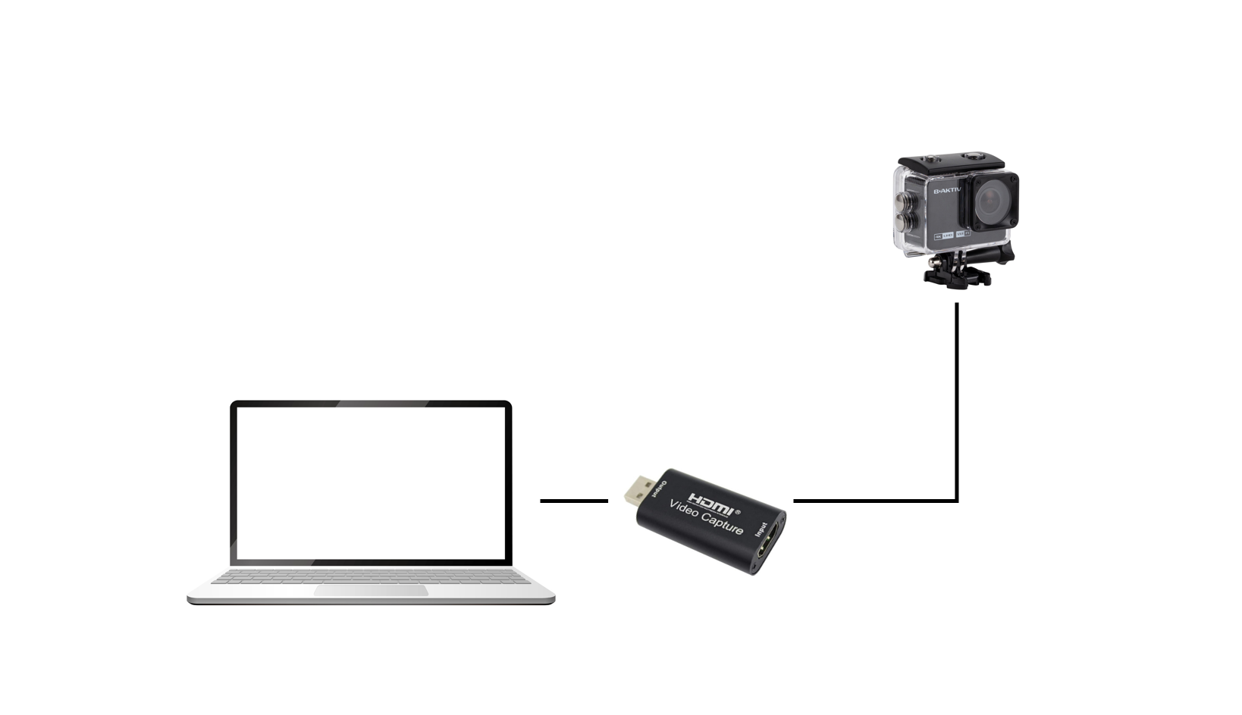

Slide 9
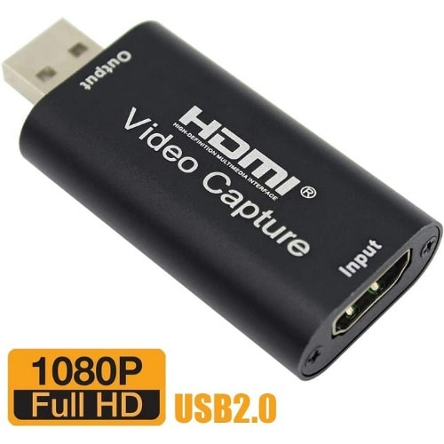

Slide 10
UI Design (member)

Slide 11
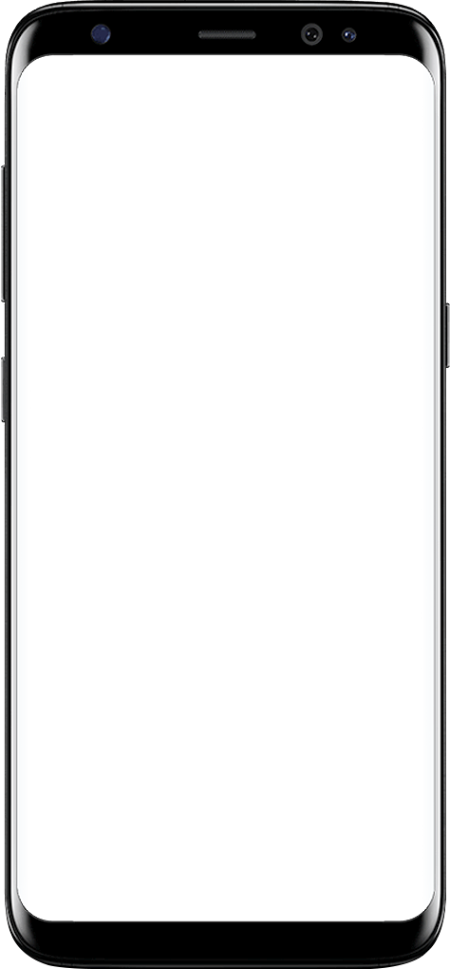

Login
Username
Password
Login

Slide 12
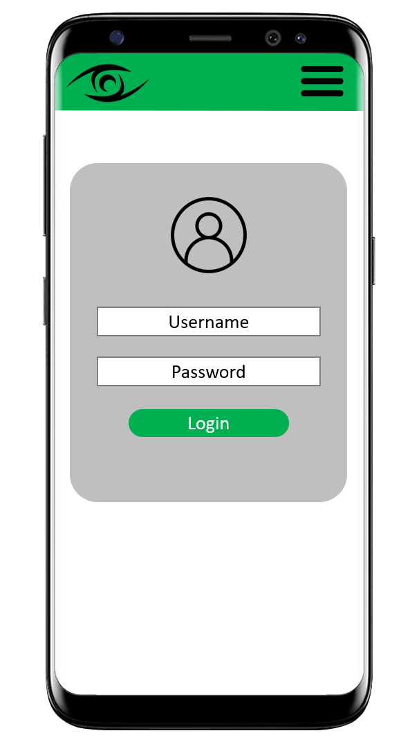

Slide 13
View livestreams
Access times
Livestreams

Slide 14
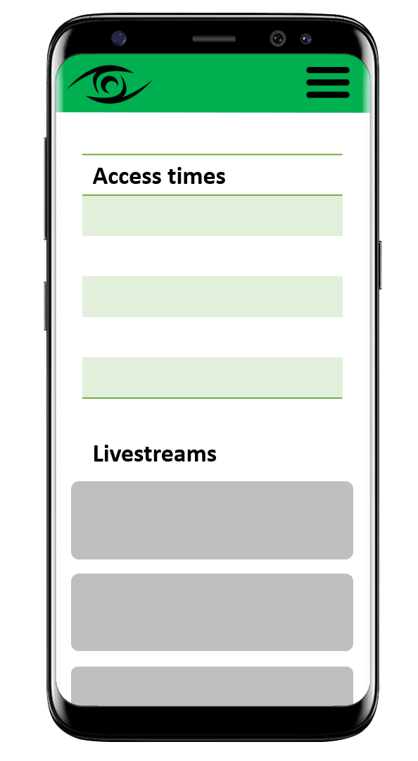

Slide 15
View messages
Messages
!
!

Slide 16
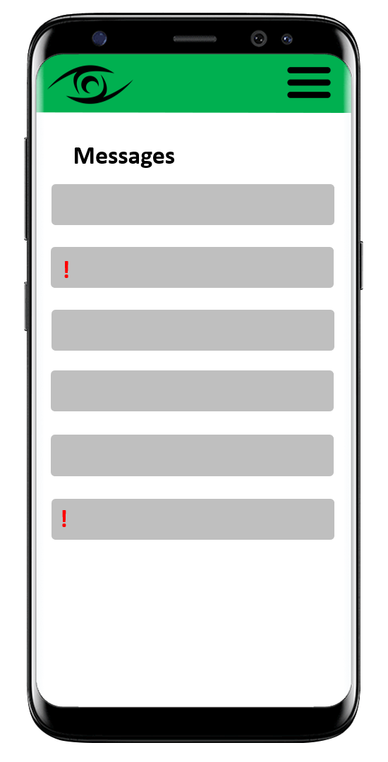

Slide 17
View facility information
Facility information

Slide 18
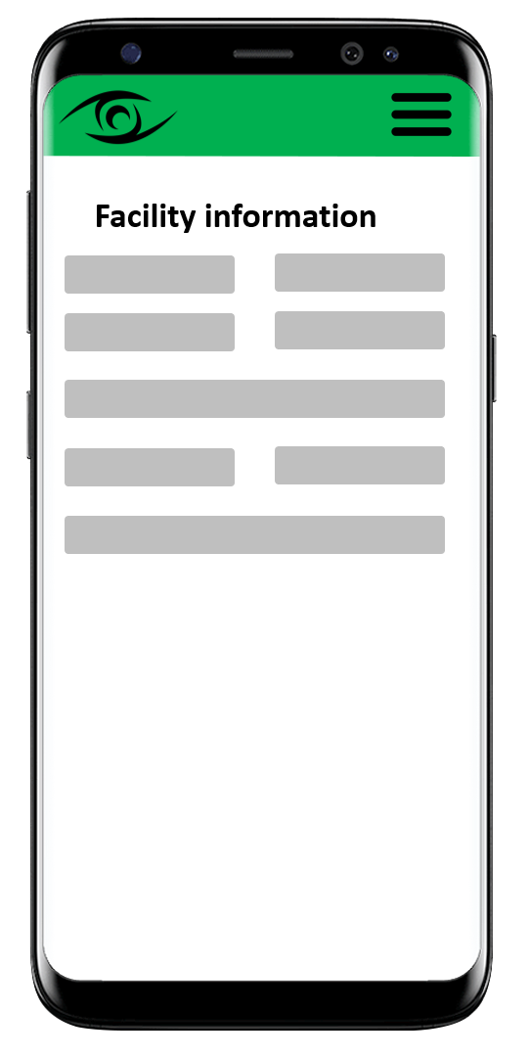

Slide 19
UI Design (facility)

Slide 20

Login
Members Livestreams Messages Account
Username
Password
Login

Slide 21
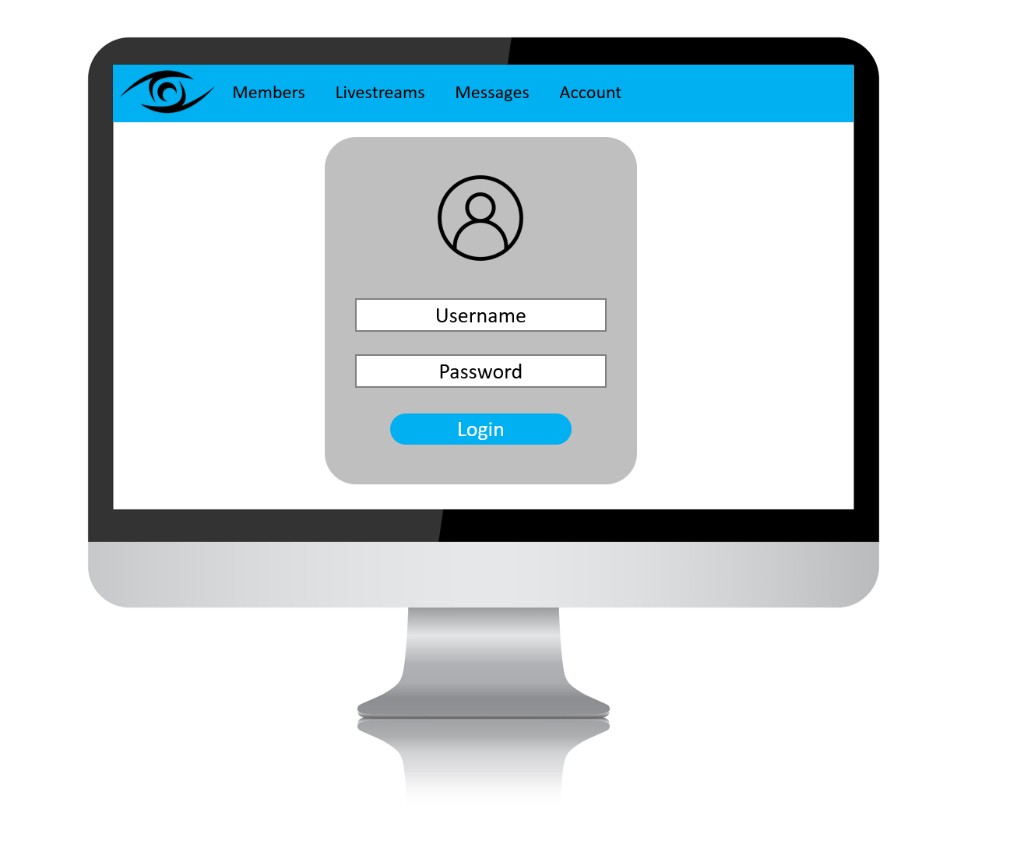

Slide 22
Manage
members
Members Livestreams Messages Account
Active members
Requests
Idle members
Member details
Change member status
Access times
Change access times

Slide 23
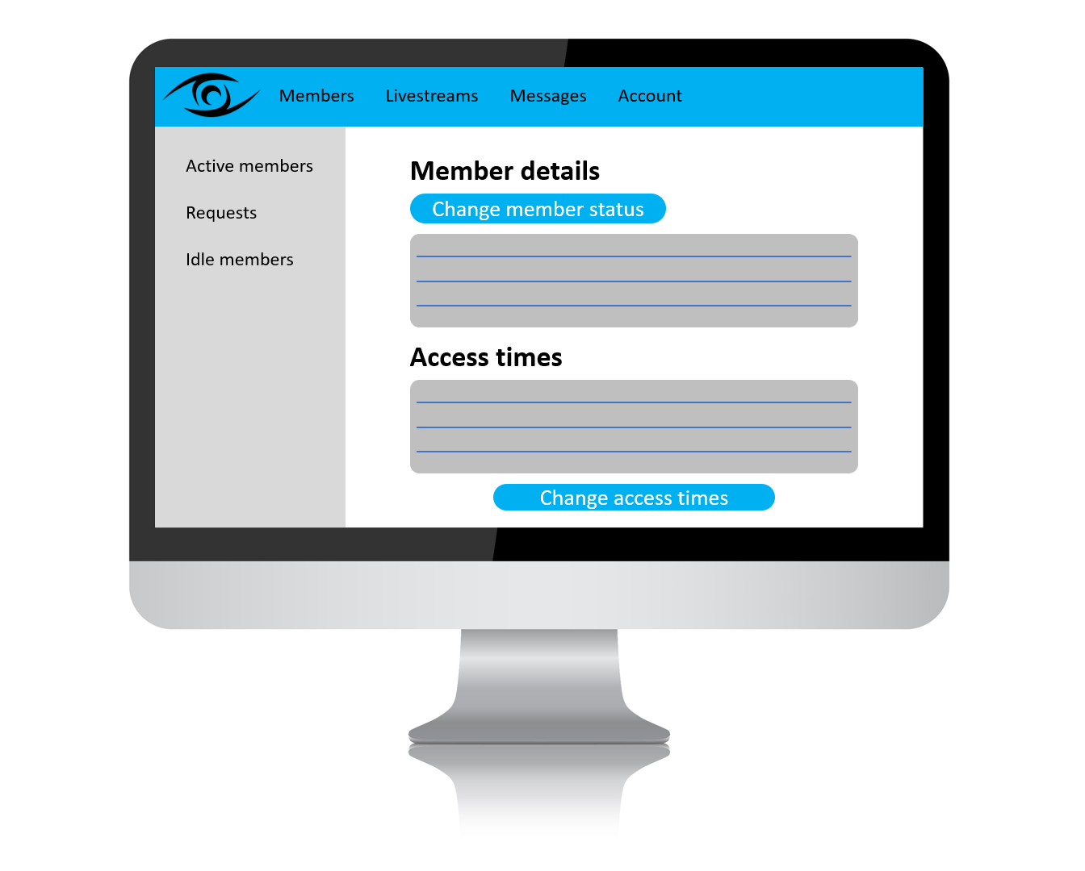

Slide 24
Manage
livestreams
Members Livestreams Messages Account
Livestreams
New livestream
Title
Comments
URL
Create livestream
Existing livestreams

Slide 25
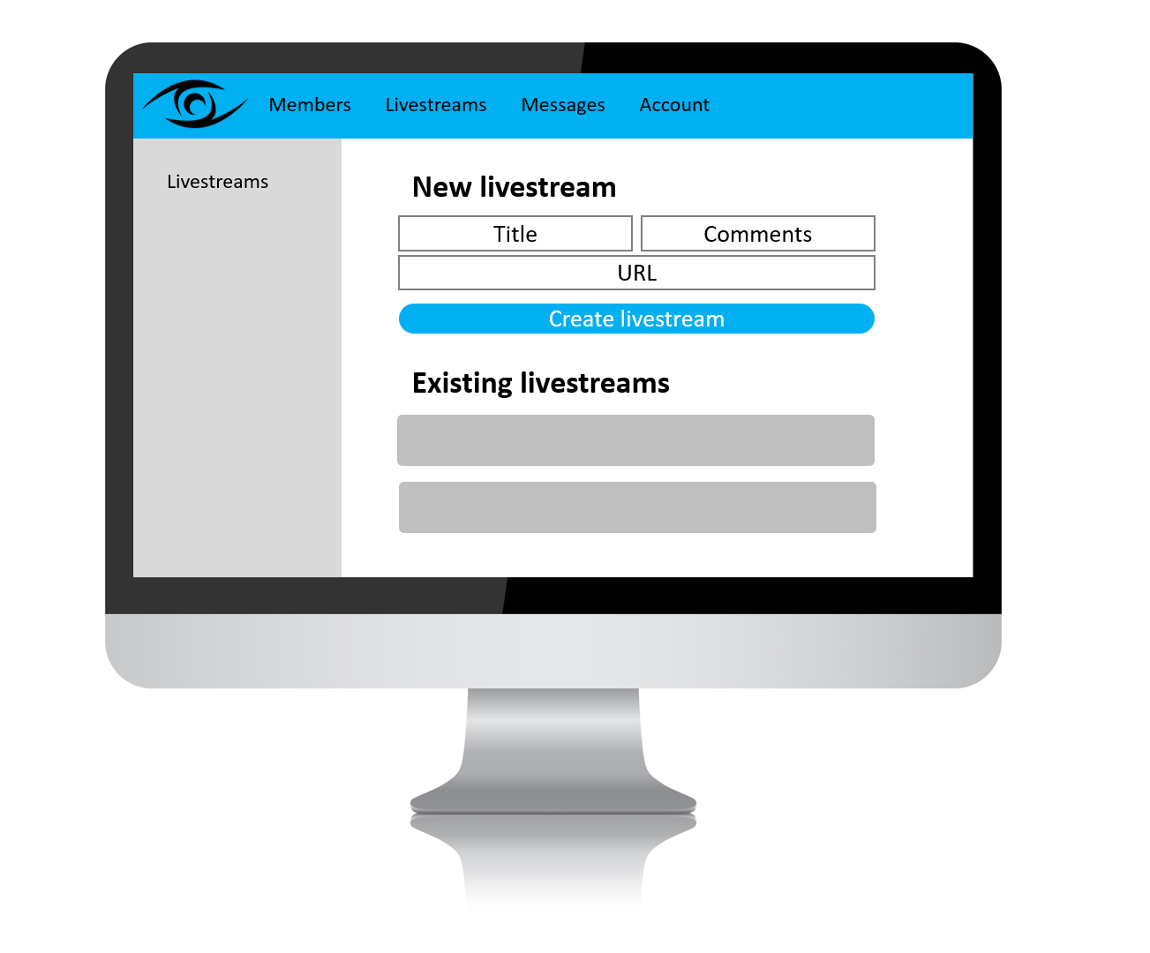

Slide 26
Manage
messages
Members Livestreams Messages Account
Messages
New message
Title
Urgency level
Content
Create new message
Existing messages

Slide 27
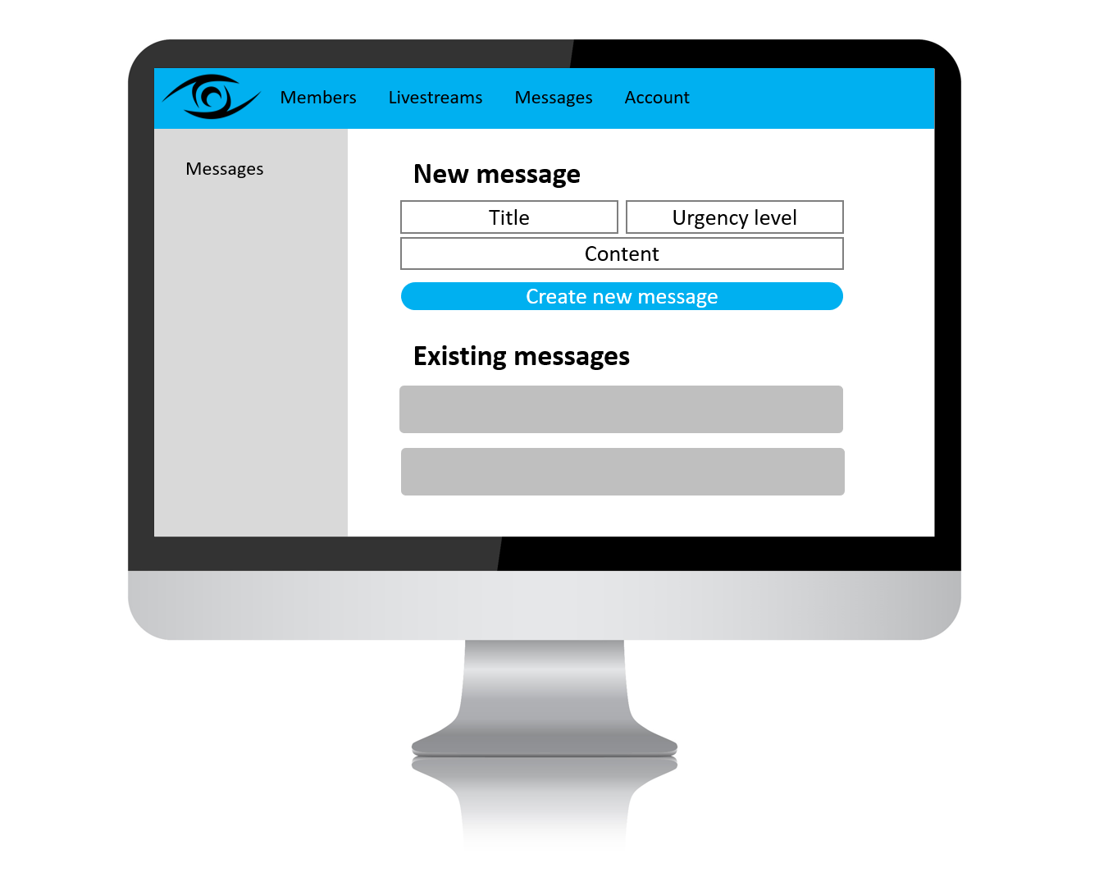

Slide 28
Manage
account
Members Livestreams Messages Account
Account details
Documentation
Logout
Account details
Change details

Slide 29
